Slide 1

INDIAN INSTITUTE OF INFORMATION TECHNOLOGY
ALLAHABAD
Project done under the guidance of
( Dr.Triloki Pant )

Slide 2
Face Detection
Submitted by:
Mohammad Meraj IIT2017024
Akash Kumar IIT2017047
Sachin Sharma IIT2017099
Aman Kumar Anshu IIT2017132
Roshan Baghwar IIT2017147

Slide 3
Abstract
Human face detection has become a major field of interest in current research because there is no deterministic algorithm to find face(s) in a given image.
We have been seeing that online sites like Amazon, Flipkart and Facebook have developed a strange ability to detect objects in photographs. Previously, we have to tag the object by clicking on it. We must also have observed that while posting any group pic on Facebook they detect every face in the window. This technology is face detection.

Slide 4
Introduction
A model that can be used in many types of devices to detect digital images are called face detection. It is a specific case of object-class detection. In the search of the location and size of all the features belonging to a given class. The main priority of this model will be on the frontal face detection. In this face-detection model, it firstly detects expected human eye areas by first evaluating all the possible valley regions in the given gray-level frame or picture.
A model is used in many types of devices for detecting the digital images on viewpoint window are called face detection. Face detection belongs to a specific case of the object-class detection.

Slide 5
Project Perspective
Main perspective of our project is to detect the faces from given image as input and detect faces in real-time stream. Our project take the input and process it and produce output as identifying face and keep it inside red frame.

Slide 6
Methodology
We are using a Deep Learning approach in which Convolutional Neural Network (CNN) Algorithms is used for face detection.CNN determines the features of faces using the Eigenvalues of faces which are predefined inside algorithm.

Slide 7
How it’s Working
The pre-trained deep learning-based files are fed as the input arguments.
The program takes the visual input from the camera and stores the facial information in the numpy array.
Using deep learning techniques, it identifies the faces and draws a rectangle around the detected faces.

Slide 8
Functions
System’s Input- Here we give the input through the camera or webcam it may be a image or in the form of video stream.
Data Processing- Here we have libraries like opencv by which our system process the input data and make a decision that it is a face or not.
Expected Output- Our expected output is that if input have human faces than it detect it.

Slide 9
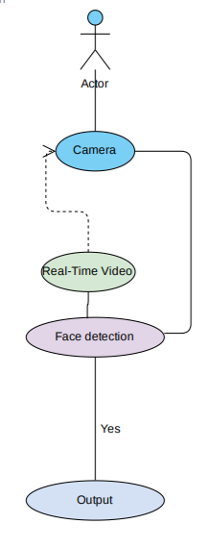
Use Case Diagram

Slide 10
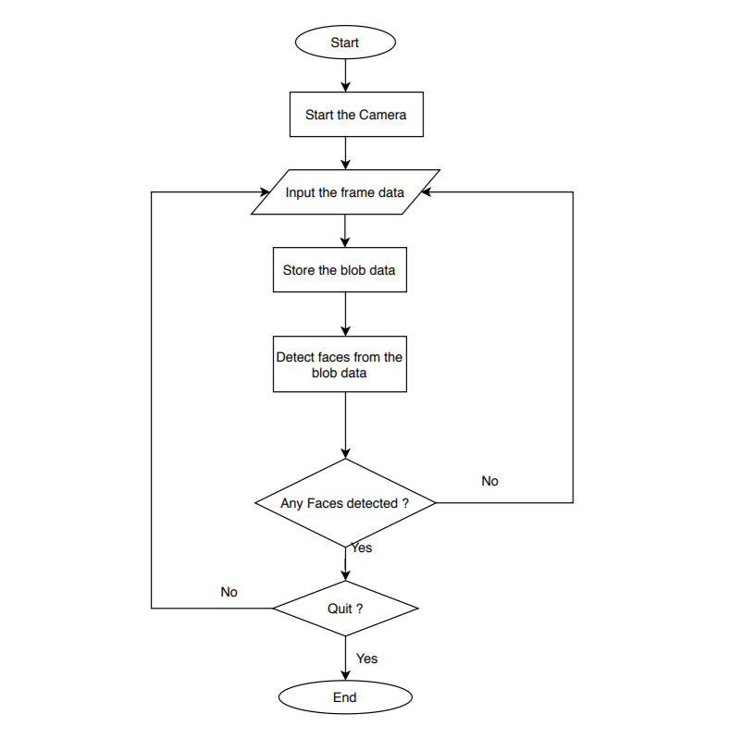
Flow Chart

Slide 11
Result
The proposed model is able to detect faces correctly but when tried for videos, it takes more time for processing. The advantage of this model is that it is able to recognize faded pictures and side face images also which other traditional models are incapable of recognizing in such cases.
The only drawback is that while detecting image during capturing images it fails to detect side views of the face
Results are shown in Fig (A) , Fig(B), Fig (C)

Slide 12
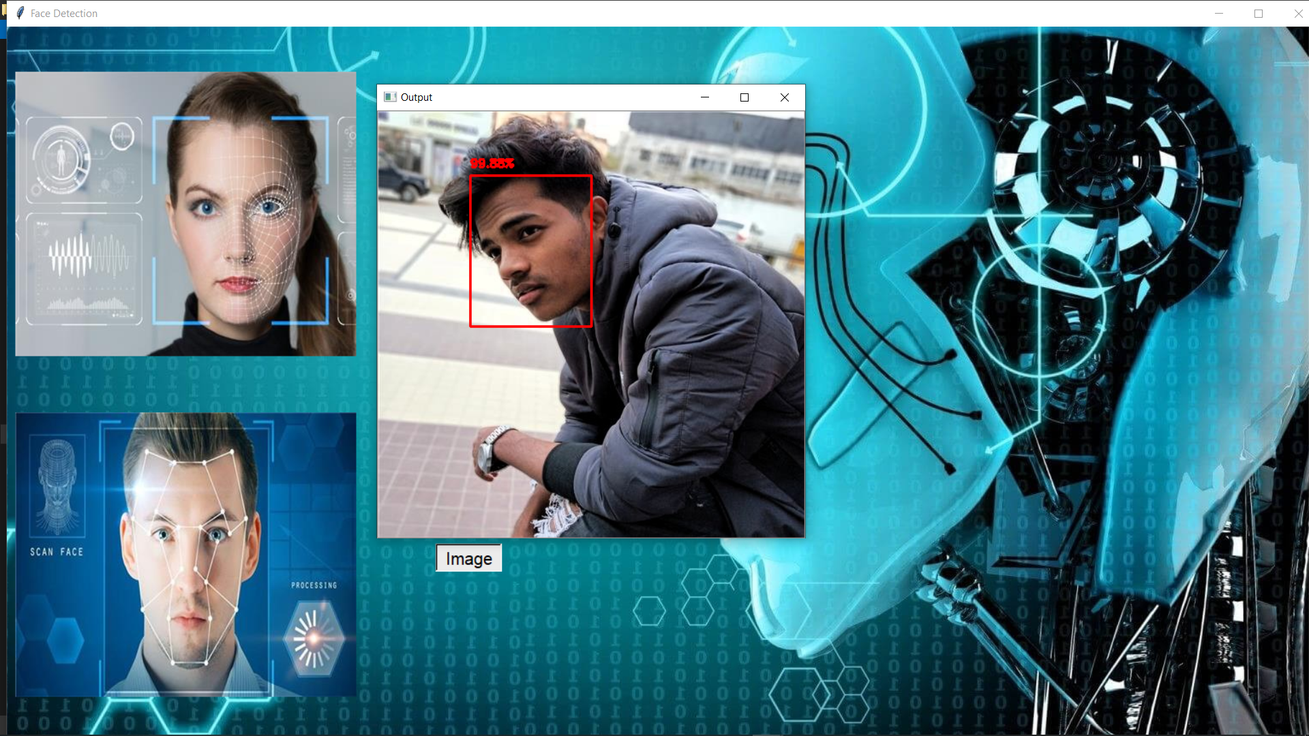
Fig (A)

Slide 13
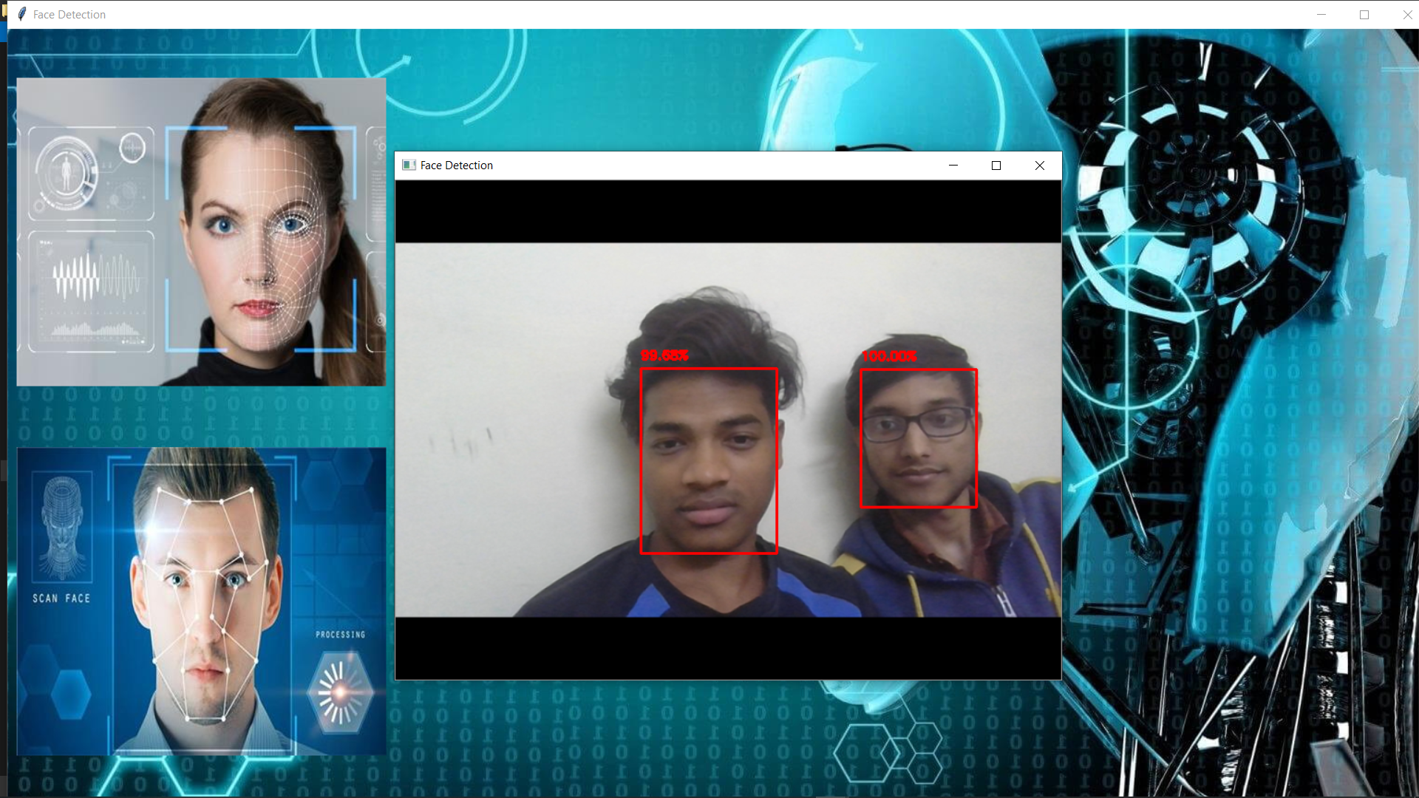
Fig (B)

Slide 14
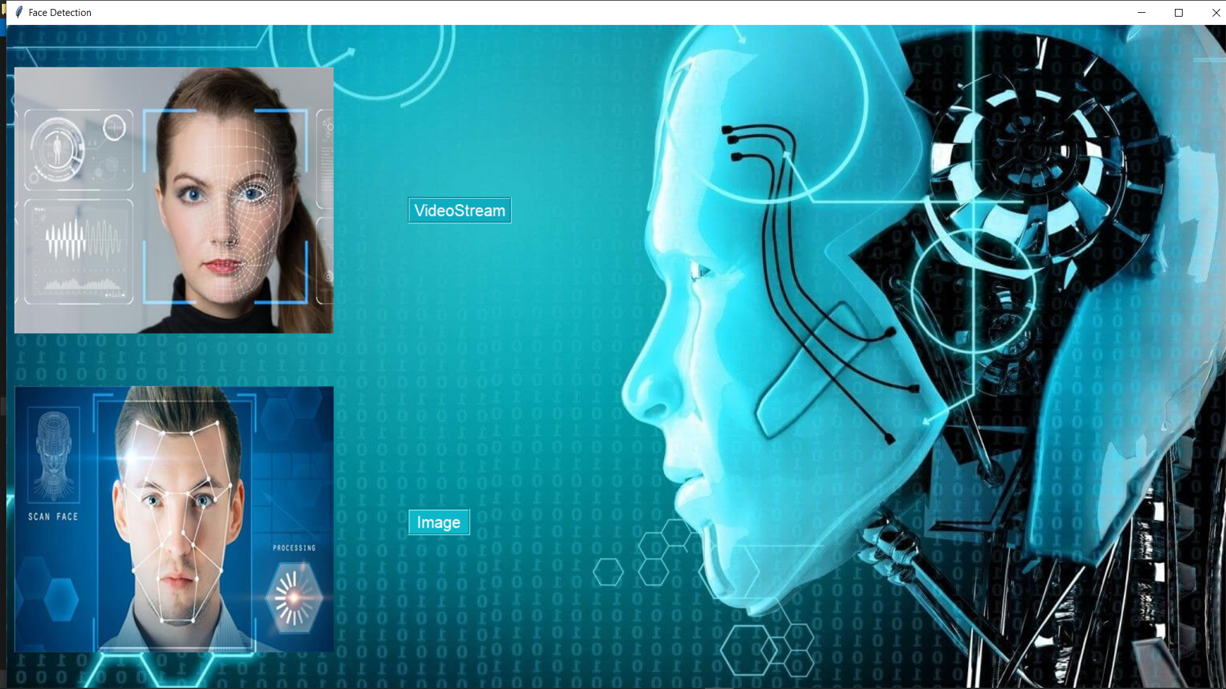
Fig (C)

Slide 15
Conclusion
The proposed model performs its functionality in an optimized way. The designed model takes more time to detect the faces when it works on videos. The main advantage of the designed model is that it can detect fade pictures, where other traditional models are not capable of detecting faces in such scenarios.
The only drawback is that while detecting face during capturing images it fails to detect the side view of the face.

Slide 16
Future Scope
Our future goals regarding face detection project are:
Provide a good UI to Users. Right now we run the program on the console which is hard to understand for users. We want to make it more in an abstract way.
Our program will be updated for face recognition as well.
In the future, proposed model can be extended to recognize the person from his face captured in footage of CCTV , that can help to get the identity of person in minimal time.

Slide 17
THANK YOU

